Slide 1

SNMP
CONCEPTS & EVOLUTION
Presented by Team B

Slide 2

SNMP CONCEPTS & EVOLUTION
Definition: SNMP is a protocol used for managing devices on IP n/w (e.g., routers, switches,).
Manager-Agent Model: SNMP operates with a manage that communicates with agents to manage and monitor network devices.
Management Information Base (MIB): A hierarchical database of network device information, where each item is assigned a unique Object Identifier (OID).
Basic Operations: The manager sends requests like GET (retrieve data) and SET (modify data), while the agent responds or sends unsolicited TRAPs (alerts).

Slide 3
SNMP EVOLUTION
SNMPv1 (1988):
First version of SNMP.
Basic functionality for monitoring and managing network devices.
Lacks security (no encryption or authentication).
SNMPv2 (1993):
Introduced improvements like bulk data retrieval (GETBULK) for more efficient data collection.
Better error handling and performance.
Limited security enhancements, still inadequate for sensitive networks.
SNMPv3 (1998):
Added strong security features, including encryption and authentication.
Focused on user-based security (USM) and view-based access control (VACM).
Fully backward-compatible with SNMPv1 and SNMPv2.

Slide 4
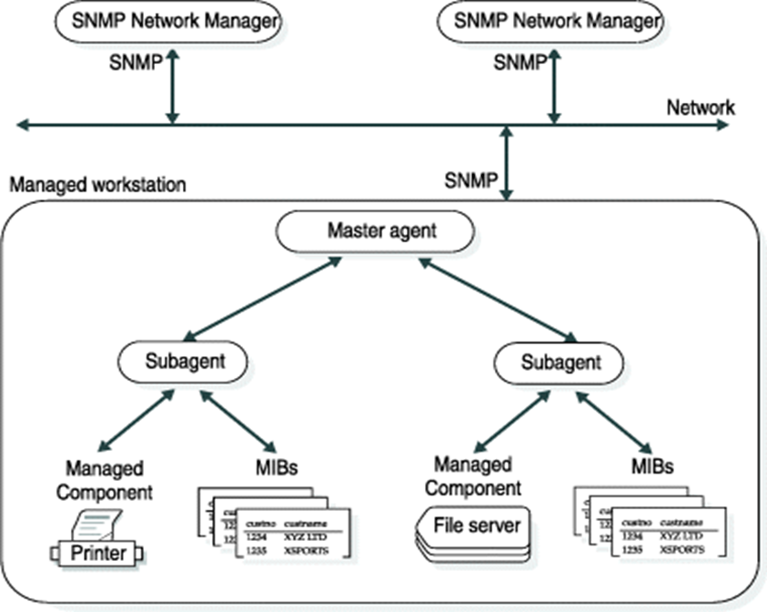
SNMP ARCHITECTURE
The Simple Network Management Protocol (SNMP) architecture includes four layers.
The SNMP architecture includes the following layers:
SNMP Network Managers
Master agents
Subagents
Managed components

Slide 5
SNMP Network Manager:
Software that requests and displays data from master agents. It allows selection of items to monitor and how to display them.
Master Agent:
Interface between the SNMP Network Manager and subagents.
Subagent:
Software that provides data to the master agent.
Managed Component:
Hardware or software (e.g., routers, servers) that provides a subagent for monitoring.
.

Slide 6
Managed Component:
Devices or software (like servers, routers, or printers) that send data through a subagent.
Management Information Base (MIB):
Lists of data that a subagent shares with the master agent, using SNMP rules.

Slide 7
SNMP QUERY
SNMP Queries are interactions between the manager and the agent. The manager sends requests, and the agent responds with information.
Query Types:
GET: Retrieves a specific variable from an agent.
GETNEXT: Retrieves the next variable in the MIB tree.
GETBULK: Efficient retrieval of large data sets (supported in SNMPv2 and later).
SET: Modifies a variable in the agent’s MIB.

Slide 8
SNMP COMMANDS
Basic Commands:
GET: Requests the value of a specific object.
SET: Modifies the value of a specific object.
GETNEXT: Retrieves the next object in sequence.
GETBULK: Fetches multiple data points efficiently.
TRAP: Asynchronous notification from the agent to the manager (e.g., when something goes wrong).
INFORM: Similar to TRAP but expects an acknowledgment.

Slide 9
SNMP TRAPS
TRAPS:
Definition: An unsolicited message from an agent to the manager to alert about critical events.
Use Case: Alert for system failures, high CPU usage, interface down, etc.
Types:
ColdStart: The device has rebooted.
LinkDown: Network interface went down.
AuthenticationFailure: An invalid community string was used in an SNMP request.

Slide 10
YANG EVOLUTION & BACKGROUND
YANG: A language for setting up and monitoring network devices.
Background: Created by IETF to improve on SNMP for more complex networks. Often used with NETCONF and RESTCONF.
Advantages:
Clear data definitions.
Handles both configuration and status info.
Works across different vendors, using a model-driven approach.

Slide 11
SNMP LIMITATION
Key Limitations:
Security: Early versions (SNMPv1, v2) lacked encryption and strong authentication.
Scalability & Overhead: Inefficient for large networks and frequent polling strains resources.
Limited Write Capabilities: Primarily read-focused with fragmented vendor MIB implementations.

Slide 12
OPERATORS' REQUIREMENT
Modern Network Management Needs:
Enhanced Security: Strong encryption and authentication are needed, improved in SNMPv3 but still limited.
Real-time Alerts: Immediate insights are essential, like SNMP TRAPs or newer methods with YANG/NETCONF.
Automation: Automated configuration and policy management are crucial, where SNMP falls short but YANG excels.
Interoperability: Need for vendor-neutral management across various devices.

